Slide 1
Applied Physics(C. Sc.) BS CS Semester-I Course Code: L-10(Photoelectric effect) IUB & All Affiliated Colleges. Reality Awards Boost Up (YT-Channel)
Rushmat Ali
Assistant Professor OF Physics
Govt. Kh. F. Graduate College R. Y. Khan

Slide 2
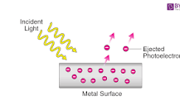
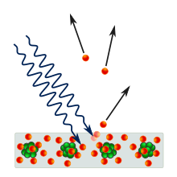
Photo-Electric Effect:
a phenomenon in which electrons are ejected from the surface of a metal when light is incident on it. These ejected electrons are called photoelectrons.
The phenomenon is studied in condensed matter physics, solid state, and quantum chemistry to draw inferences about the properties of atoms, molecules and solids. The effect has found use in electronic devices specialized for light detection and precisely timed electron emission.
Historitorical Background:
In 1839, Alexandre Edmond Becquerel discovered the photovoltaic effect while studying the effect of light on electrolytic cells.
In 1873, Willoughby Smith discovered photoconductivity in selenium while testing the metal for its high resistance properties.
Johann Elster (1854–1920) and Hans Geitel (1855–1923), students in Heidelberg, investigated the effects produced by light on electrified bodies and developed the first practical photoelectric cells that could be used to measure the intensity of light.
In 1887, Heinrich Hertz observed the photoelectric effect[26] and reported on the production and reception[27] of electromagnetic waves.
a series of investigations by Wilhelm Hallwachs, Hoor, Augusto Righi and Aleksander Stoletov on the effect of light, and especially of ultraviolet light,
In 1897, J. J. Thomson investigated ultraviolet light in Crookes tubes.
In 1902, Lenard observed that the energy of individual emitted electrons was independent of the applied light intensity
In 1900, while studying black-body radiation, the German physicist Max Planck suggested in his "On the Law of Distribution of Energy in the Normal Spectrum"[45] paper that the energy carried by electromagnetic waves could only be released in packets of energy. In 1905, Albert Einstein published a paper advancing the hypothesis that light energy is carried in discrete quantized packets to explain experimental data from the photoelectric effect.

Slide 3
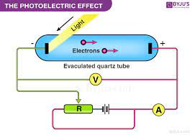
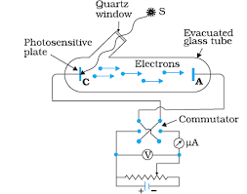
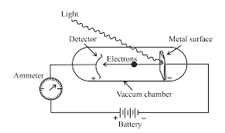
Experimental observation of photoelectric emission
Even though photoemission can occur from any material, it is most readily observed from metals and other conductors. This is because the process produces a charge imbalance which, if not neutralized by current flow, results in the increasing potential barrier until the emission completely ceases. The energy barrier to photoemission is usually increased by nonconductive oxide layers on metal surfaces, so most practical experiments and devices based on the photoelectric effect use clean metal surfaces in evacuated tubes. Vacuum also helps observing the electrons since it prevents gases from impeding their flow between the electrodes.[citation needed]
As sunlight, due to atmosphere's absorption, does not provide much ultraviolet light, the light rich in ultraviolet rays used to be obtained by burning magnesium or from an arc lamp. At the present time, mercury-vapor lamps, noble-gas discharge UV lamps and radio-frequency plasma sources,[7][8][9] ultraviolet lasers,[10] and synchrotron insertion device[11] light sources prevail.
Schematic of the experiment to demonstrate the photoelectric effect. Filtered, monochromatic light of a certain wavelength strikes the emitting electrode (E) inside a vacuum tube. The collector electrode (C) is biased to a voltage VC that can be set to attract the emitted electrons, when positive, or prevent any of them from reaching the collector when negative.
The classical setup to observe the photoelectric effect includes a light source, a set of filters to monochromatize the light, a vacuum tube transparent to ultraviolet light, an emitting electrode (E) exposed to the light, and a collector (C) whose voltage VC can be externally controlled.[citation needed]
A positive external voltage is used to direct the photoemitted electrons onto the collector. If the frequency and the intensity of the incident radiation are fixed, the photoelectric current I increases with an increase in the positive voltage, as more and more electrons are directed onto the electrode. When no additional photoelectrons can be collected, the photoelectric current attains a saturation value. This current can only increase with the increase of the intensity of light.[citation needed]
An increasing negative voltage prevents all but the highest-energy electrons from reaching the collector. When no current is observed through the tube, the negative voltage has reached the value that is high enough to slow down and stop the most energetic photoelectrons of kinetic energy Kmax. This value of the retarding voltage is called the stopping potential or cut off potential Vo.[12] Since the work done by the retarding potential in stopping the electron of charge e is eVo, the following must hold eVo = Kmax.
The current-voltage curve is sigmoidal, but its exact shape depends on the experimental geometry and the electrode material properties.
For a given metal surface, there exists a certain minimum frequency of incident radiation below which no photoelectrons are emitted. This frequency is called the threshold frequency. Increasing the frequency of the incident beam increases the maximum kinetic energy of the emitted photoelectrons, and the stopping voltage has to increase. The number of emitted electrons may also change because the probability that each photon results in an emitted electron is a function of photon energy.
An increase in the intensity of the same monochromatic light (so long as the intensity is not too high[13]), which is proportional to the number of photons impinging on the surface in a given time, increases the rate at which electrons are ejected—the photoelectric current I—but the kinetic energy of the photoelectrons and the stopping voltage remain the same. For a given metal and frequency of incident radiation, the rate at which photoelectrons are ejected is directly proportional to the intensity of the incident light.
The time lag between the incidence of radiation and the emission of a photoelectron is very small, less than 10−9 second. Angular distribution of the photoelectrons is highly dependent on polarization (the direction of the electric field) of the incident light, as well as the emitting material's quantum properties such as atomic and molecular orbital symmetries and the electronic band structure of crystalline solids. In materials without macroscopic order, the distribution of electrons tends to peak in the direction of polarization of linearly polarized light.[14] The experimental technique that can measure these distributions to infer the material's properties is angle-resolved photoemission spectroscopy.

Slide 4
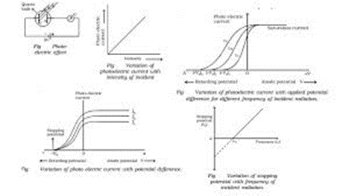
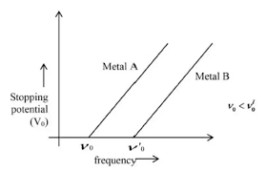
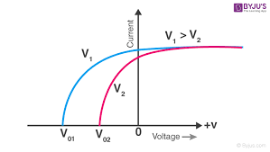
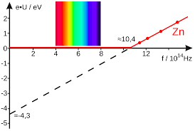
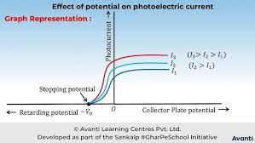

Slide 5
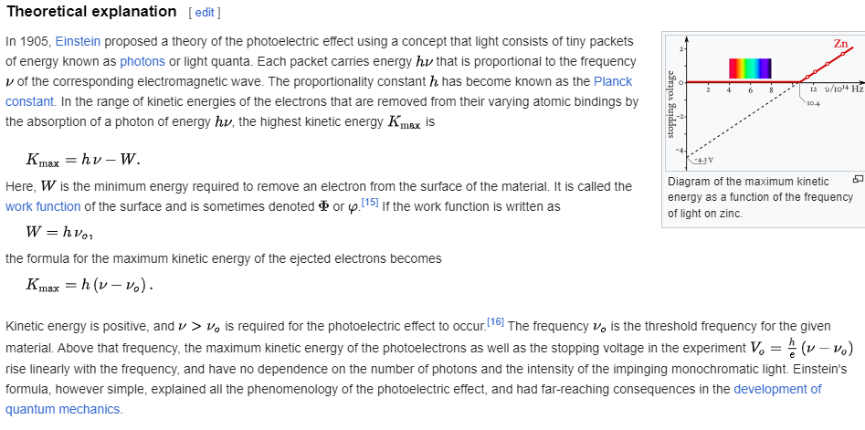
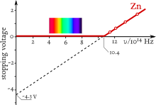
Models of photoemission from solids
The electronic properties of ordered, crystalline solids are determined by the distribution of the electronic states with respect to energy and momentum—the electronic band structure of the solid. Theoretical models of photoemission from solids show that this distribution is, for the most part, preserved in the photoelectric effect. The phenomenological three-step model[17] for ultraviolet and soft X-ray excitation decomposes the effect into these steps:[18][19][20]
Inner photoelectric effect in the bulk of the material that is a direct optical transition between an occupied and an unoccupied electronic state. This effect is subject to quantum-mechanical selection rules for dipole transitions. The hole left behind the electron can give rise to secondary electron emission, or the so-called Auger effect, which may be visible even when the primary photoelectron does not leave the material. In molecular solids phonons are excited in this step and may be visible as satellite lines in the final electron energy.
Electron propagation to the surface in which some electrons may be scattered because of interactions with other constituents of the solid. Electrons that originate deeper in the solid are much more likely to suffer collisions and emerge with altered energy and momentum. Their mean-free path is a universal curve dependent on electron's energy.
Electron escape through the surface barrier into free-electron-like states of the vacuum. In this step the electron loses energy in the amount of the work function of the surface, and suffers from the momentum loss in the direction perpendicular to the surface. Because the binding energy of electrons in solids is conveniently expressed with respect to the highest occupied state at the Fermi energy
E_F, and the difference to the free-space (vacuum) energy is the work function of the surface, the kinetic energy of the electrons emitted from solids is usually written as
{\displaystyle E_{k}=h\nu -W-E_{B}}.

Slide 6
The characteristics of the Photoelectric effect are:
No lag time in the emission of photoelectrons.
There is an increase in the kinetic energy of the emission of photoelectrons with the increase in the intensity of the radiation.
The cut-off frequency influences the photocurrent.

Slide 7
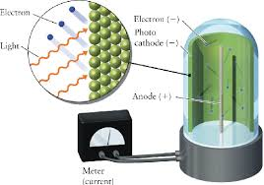
applications of photoelectric cells:
There are many applications of photoelectric cells in our daily lives. Given below are 5 important applications of photoelectric cells:
1. Photoelectric cells are used to control the temperatures of furnaces.
2. Photoelectric cells are used in the study of the spectra of stars and temperature.
3. Photoelectric cells are used in cinematography to reproduce sound.
4. Photoelectric cells are used in street lights so that they can be switched on and off automatically.
5. Photoelectric cells are used during space travel to obtain electrical energy from sunlight.
A photoelectric cell is an application of the photoelectric effect. A photoelectric cell has a semi-cylindrical photosensitive metal plate, called the emitter and a wire loop called the collector which is supported by an evacuated glass or quartz bulb. This is then connected to an external circuit with a microammeter and a high-tension battery. When light having a suitable wavelength falls on the emitter, photoelectrons will be emitted. The photoelectrons will then be drawn towards the collector photocell and will convert the change in the intensity of illumination into a change in the photocurrent. The minimum of anode potential that can stop the photocurrent is known as the stopping potential, which can stop even the most energetic electrons. This stopping potential only depends on the work function of the metal and the wavelength of light. The stopping potential has no relation to the intensity of light.

Slide 8
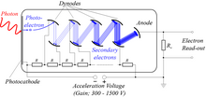
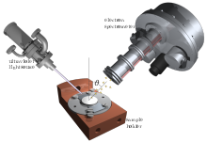
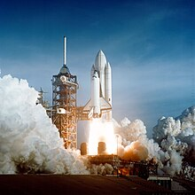
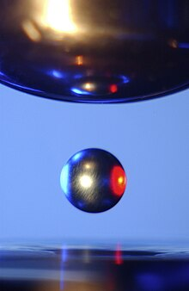
Uses and effects
Photomultipliers: These are extremely light-sensitive vacuum tubes with a coated photocathode inside the envelope.
Image sensors: Video camera tubes in the early days of television used the photoelectric effect, for example, Philo Farnsworth's "Image dissector" used a screen charged by the photoelectric effect to transform an optical image into a scanned electronic signal.
Photoelectron spectroscopy: Photoelectron spectroscopy measurements are usually performed in a high-vacuum environment,
Night vision devices: Photons hitting a thin film of alkali metal or semiconductor material such as gallium arsenide in an image intensifier tube cause the ejection of photoelectrons due to the photoelectric effect.
Spacecraft: The photoelectric effect will cause spacecraft exposed to sunlight to develop a positive charge. This can be a major problem, as other parts of the spacecraft are in shadow which will result in the spacecraft developing a negative charge from nearby plasmas.
Moon dust: Light from the Sun hitting lunar dust causes it to become positively charged from the photoelectric effect. The charged dust then repels itself and lifts off the surface of the Moon by electrostatic levitation.

